Slide 1
1
1

Slide 2
Contents
Introduction
Research Objective
Hardware Design
Software Design
Result
Conclusion and Future Direction
*
2

Slide 3



1. Introduction
Large Language Models (LLMs)
NET USD 5,617.4 million
3

Slide 4

1. Introduction
4

Slide 5
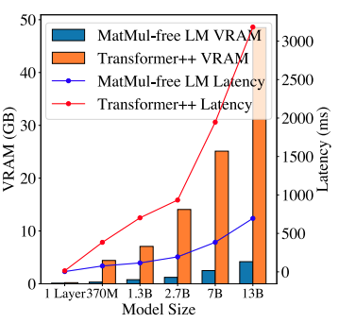
1. Introduction
Comparison of GPU Memory and Latency in inference between MatMul-free LM and Transformer++
5

Slide 6
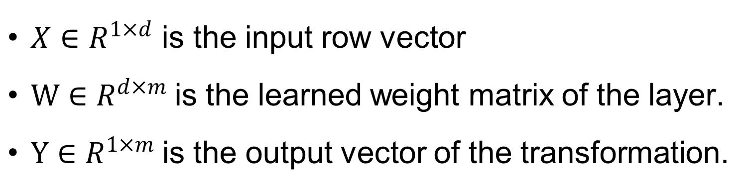
1. Introduction
LLMs rely heavily on linear transformations
Y=XW+b
$X∈R^{1×d}$ is the input row vector
$W∈R^{d×m}$is the learned weight matrix of the layer.
$Y∈R^{1×m}$is the output vector of the transformation.
Note: This hardware design focus on d=512, m=512
6

Slide 7
1. Introduction
Standard GRU
7

Slide 8
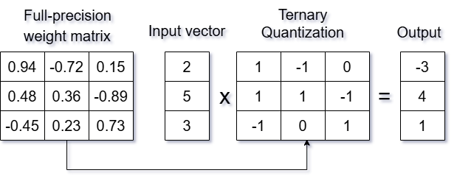
1. Introduction
Transformation from a full-precision weight matrix to a ternary matrix
where Δ=mean(∣W∣)
8

Slide 9
2. Research Objective
A hardware-level implementation of MatMul-free token generation tailored for LLMs.
A custom instruction set and RISC-style pipeline supporting vectorized and ternary operations.
A processor which can run parallel matrix operation and ternary matrix for LLMs
Empirical benchmarks and comparisons with related works
9

Slide 10
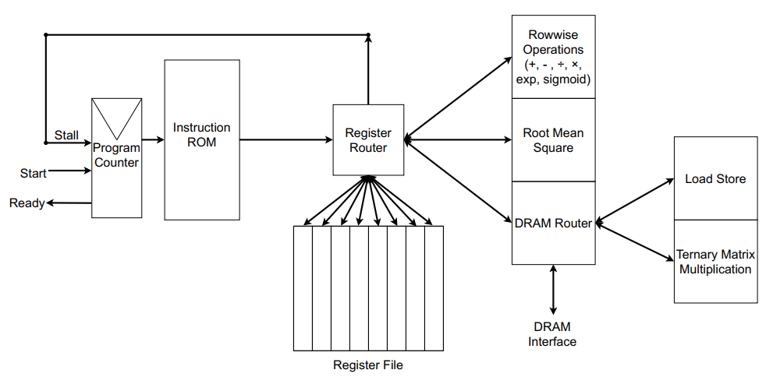
2. Research Objective
10

Slide 11
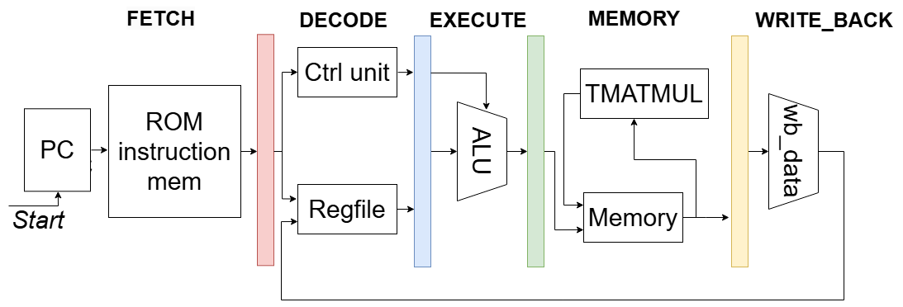
3. Hardware Implementation
Overall Schematic
11

Slide 12
3. Hardware Implementation
Instruction Memory is utilized to store the program containing custom instructions
PC retrieves instructions directly from the ROM, preparing them for subsequent processing stages.
12

Slide 13
3. Hardware Implementation
The Control Unit (Ctrl Unit) decodes the fetched instructions and generates control signals (ctrl_signal)
Register File (Regfile) contains general-purpose vector registers that provide register data (Reg_data)
13

Slide 14
3. Hardware Implementation
Arithmetic Logic Unit (ALU), which handles element-wise vector operations:
Addition (ADD), subtraction (SUB), multiplication (MUL), division (DIV).
Activation functions (SIG, EXP).
Vector normalization.
14

Slide 15
3. Hardware Implementation
TMATMUL (Ternary Matrix Multiplication) block is specialized hardware module is dedicated to performing ternary matrix-vector multiplications.
Memory Unit is responsible for general-purpose memory operations, this unit handles loading and storing vectors from memory.
15

Slide 16
3. Hardware Implementation
Inst | Opcode | Operation | Description
LDV | 1001 | LDV R1, V1 | Load vector from DRAM to a register
STV | 1010 | STV V1, R1 | Store vector from a register to DRAM
ADD | 0001 | ADD R3, R2, R1 | Row-wise Addition
SUB | 0010 | SUB R3, R2, R1 | Row-wise Subtraction
MUL | 0011 | MUL R3, R2, R1 | Row-wise Multiplication
DIV | 0100 | DIV R3, R2, R1 | Row-wise Division
EXP | 0101 | EXP R3, R2 | Row-wise Exponential Function
SIG | 0110 | SIG R3, R2 | Row-wise Sigmoid Function
NORM | 0111 | NORM R3, R2 | Performs RMS normalization on the vector
TMATMUL | 1000 | TMATMUL V3, V2, V1 | Ternary Matrix Multiplication
HALT | 1111 | - | Terminate Processor
16

Slide 17
3. Hardware Implementation
Format instruction for ADD, SUB, MUL, DIV, MATMUL
Instruction: 0001 000 001 010
R2 = 002 (V2 if TMATMUL)
R1 = 001 (V1 if TMATMUL)
R0 = 000 (Output) (V0 if TMATMUL)
Opcode = 0001 (ADD)
17

Slide 18
3. Hardware Implementation
Format instruction for LDV, STV
Instruction: 1001 000 001 010
STV: R2 = 010 | LDV: V2 = 010
index = 001
STV: V0 = 000 | LDV: R0 = 000
Opcode = 1001 (LDV)
18

Slide 19
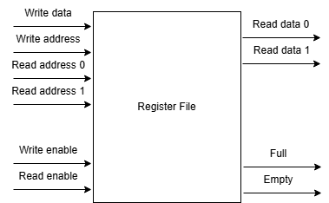
3. Hardware Implementation
Register File and FIFO Integration
19

Slide 20
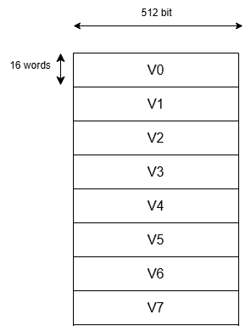
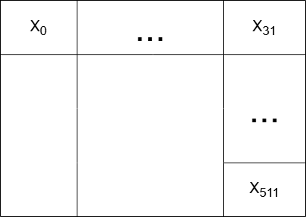
3. Hardware Implementation
20

Slide 21
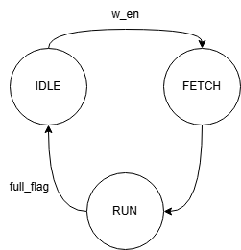
3. Hardware Implementation
IDLE waits for a write enable (w_en).
FETCH initializes the write pointer.
RUN sequentially writes 32-element vectors into memory.
Terminates when the full flag is asserted.
21

Slide 22
3. Hardware Implementation
TMATMUL Block
MUX: For ternary multiplication
01: Xnew = X
11: Xnew = -X
00: Xnew = 0
This logic is implemented using a combinational always block for all 32 elements, allowing parallel ternary operation per cycle.
22

Slide 23
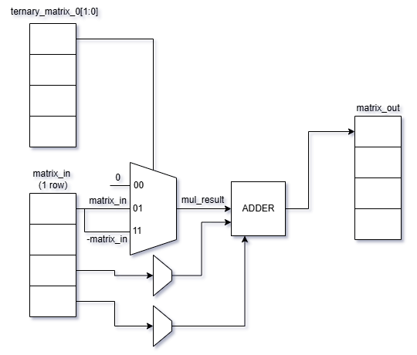
3. Hardware Implementation
TMATMUL Block for 1 row
23

Slide 24
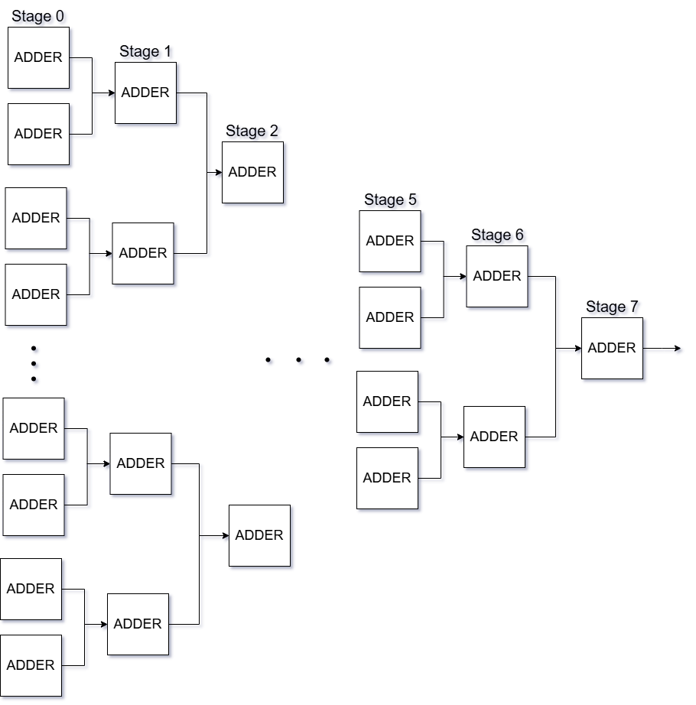
3. Hardware Implementation
Pairwise accumulation
24

Slide 25
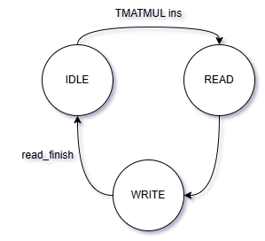
3. Hardware Implementation
TMATMUL Block
IDLE: Waits for the TMATMUL instruction and verifies memory readiness.
READ: Fetches ternary matrix and input vector from memory using dual read ports.
WRITE: Performs ternary multiplication and accumulation. Run until reach end of 512x512 matrix, end multiplication.
25

Slide 26
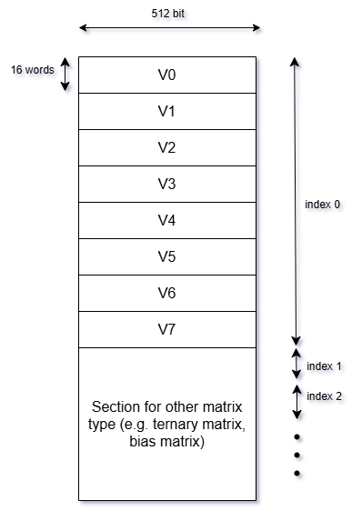
3. Hardware Implementation
Memory Subsystem
Normal mode: For typical arithmetic operations (ADD, SUB, EXP, etc.), vectors are read from compactly spaced addresses (e.g., offset by 16).
TMATMUL mode: Have various registers to save addresses, enable parallel processing while running non-memory instructions
26

Slide 27
3. Hardware Implementation
Arithmetic Logic Unit (ALU)
Arithmetic Operations:
ADD: Row-wise addition between two vectors
SUB: Row-wise subtraction
MUL: Row-wise multiplication
DIV: Row-wise division
Activation Functions:
EXP: Row-wise exponential using a lookup table
SIG: Row-wise sigmoid activation using a lookup table
Normalization:
NORM: Root Mean Square (RMS) normalization over a vector
Each operation is triggered via an ALU control signal (alu_op), which is decoded from the instruction's opcode in the Decode stage.
27

Slide 28
3. Hardware Implementation
Arithmetic Logic Unit (ALU)
To maximize parallelism, operations across vector lanes are executed concurrently. This means that for every clock cycle, 32 element-wise operations are performed in parallel across the vector lanes.
alu_in_a[i] = reg_out_0_em[16*i +: 16];
alu_in_b[i] = reg_out_1_em[16*i +: 16];
Each operation generates a result lane (alu_out[i]), which is then aggregated into the 512-bit output vector.
28

Slide 29
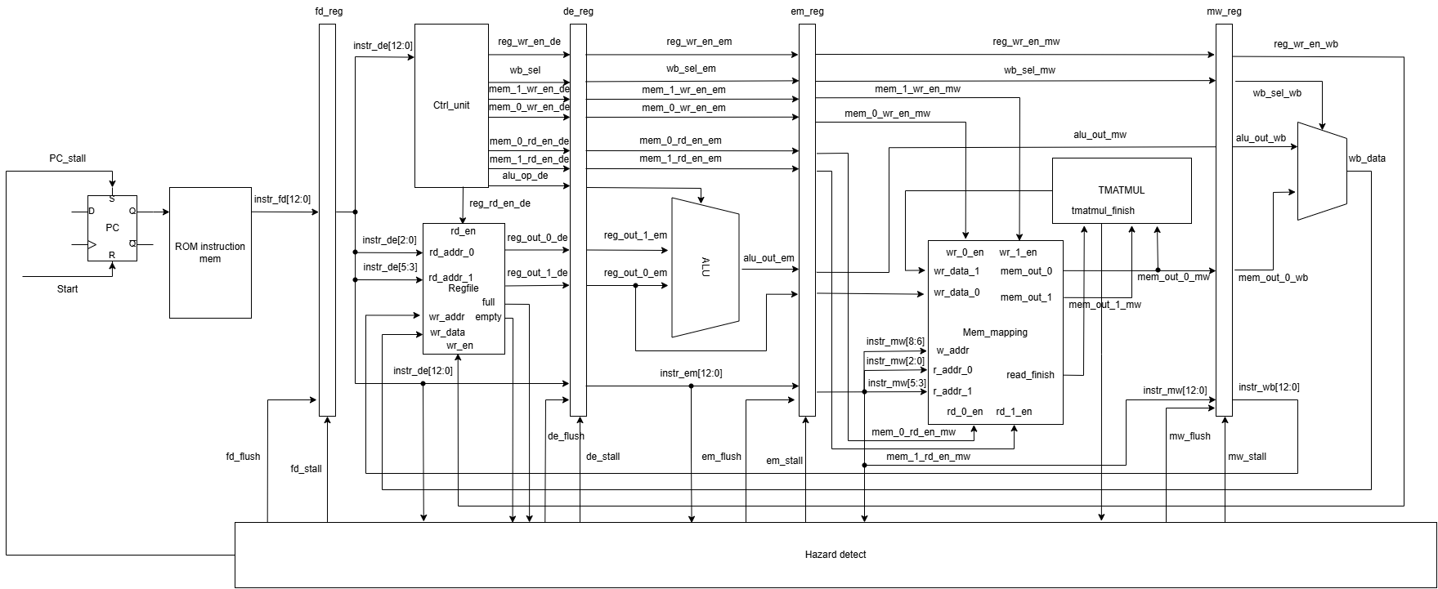
3. Hardware Implementation
29

Slide 30
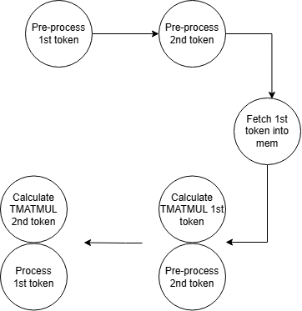
4. Software implementation
NORM X₁
Y₁=X₁W₁+B₁
SIGMOID Y₁
NORM X₂
Y₂=X₂W₂+B₂
SIGMOID Y₂
30

Slide 31
4. Software implementation
1001_000_001_000 // LOAD R0, V0, index 1
1001_000_001_001 // LOAD R2, V1, index 1 load next input
1001_101_001_010 // LOAD R5, V2, index 1 load bias
0111_001_000_000 // NORM R1, R0 normalize input x
1010_000_000_001 // STORE V0, R1, index 0
1000_100_001_000 // TMATMUL V4, V1, V0
0111_001_000_000 // NORM R3, R2
1010_000_000_001 // STORE V2, R1, index 0 Store to calcualted next tmatmul
1001_100_000_100 // LOAD R4, V4, index 0 Load tmatmul result
1000_100_001_000 // TMATMUL V5, V3, V2 Calculate next tmatmul
0001_110_100_101 // ADD R6, R4, R5 Add tmatmul results
0110_111_000_110 // SIG R7, R6 Sigmoid result
1010_010_001_111 // STORE V3, R7, index 1 Store token result
1111_111_111_111
31

Slide 32
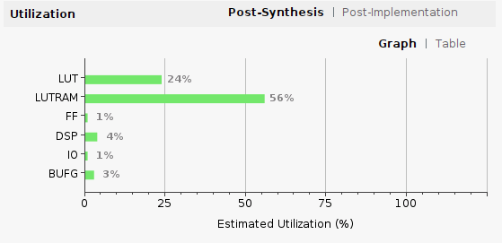
Result
Resource | Estimation | Available | Utilization %
LUT | 49,530 | 203,800 | 24.30%
LUTRAM | 35,584 | 64,000 | 55.60%
FF | 3,466 | 407,600 | 0.85%
DSP | 32 | 840 | 3.81%
IO | 5 | 500 | 1.00%
BUFG | 1 | 32 | 3.13%
32

Slide 33
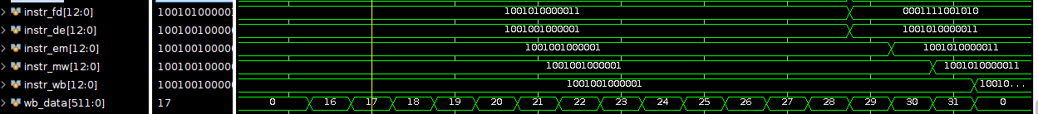
Result
Load instruction
Add instruction
Instructions are fetched into the pipeline sequentially and are propagated through the stages: instr_fd, instr_de, instr_em, instr_mw, and instr_wb.
During this period, the pipeline does not fetch new instructions
33

Slide 34
Result
TMATMUL instruction
Add instruction
Load instruction
If the following instruction does not require access to memory (e.g., an ADD operation between registers), the pipeline is permitted to continue fetching and decoding subsequent instructions even while the TMATMUL computation is ongoing. This form of hardware-level parallelism is essential to reduce overall instruction latency and maintain high pipeline throughput.
34

Slide 35
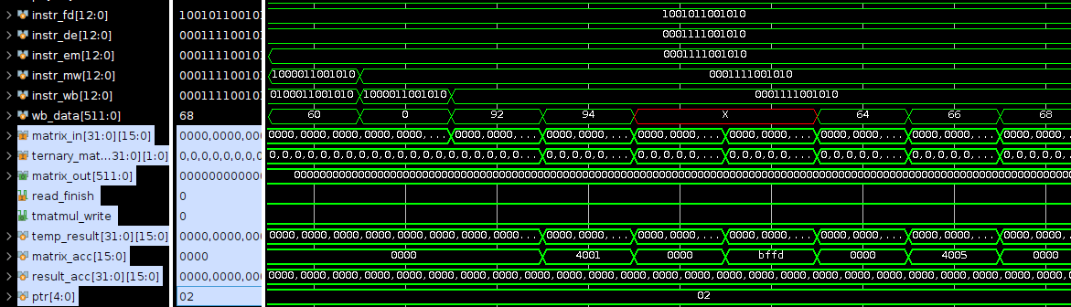
Result
Load instruction
Add instruction
While the above register fetch others instructions, the memory and ternary matrix multiplication are still running, demonstrate the parallenism of the design
35

Slide 36




Result
Total cycle when only calculate TMATMUL instruction
Normal instruction take around 16 cycles to complete calculating, while TMATMUL take more than 1000 cycles -> Take most time
Faster than normal matrix multiplication by 84%
36

Slide 37
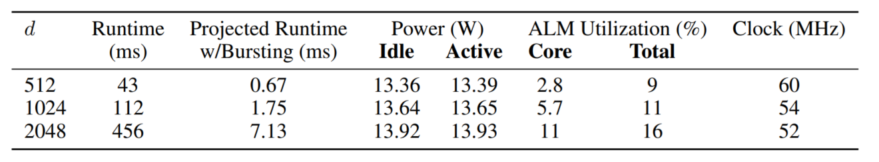
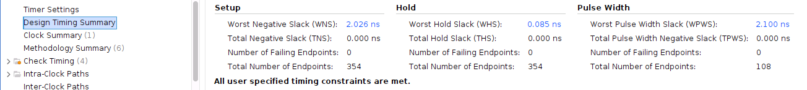
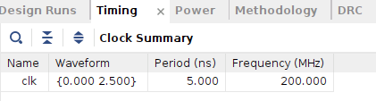
Result
The design is pipelined, therefore the design run with frequency 200MHz and hardly affected by the size of d
37

Slide 38
Future Direction
Multi-core Parallelism: Explore deployment of multi-core configurations with inter-core vector buses or NoCs (Networks-on-Chip) to enable concurrent token generation.
Instruction Fusion: Design compound instructions that combine multiple operations (e.g., TMATMUL + NORM) to reduce pipeline stalls and improve throughput.
Model Generalization: Validate the architecture on larger models (10B+ parameters) and diverse token types beyond 1×512 vectors.
Dynamic Matrix Scaling: Extend support for variable matrix dimensions (e.g., 256, 1024) through parameterizable datapaths and segmented memory mapping.
38

Slide 39
THANK YOU…
39

